Slide 1
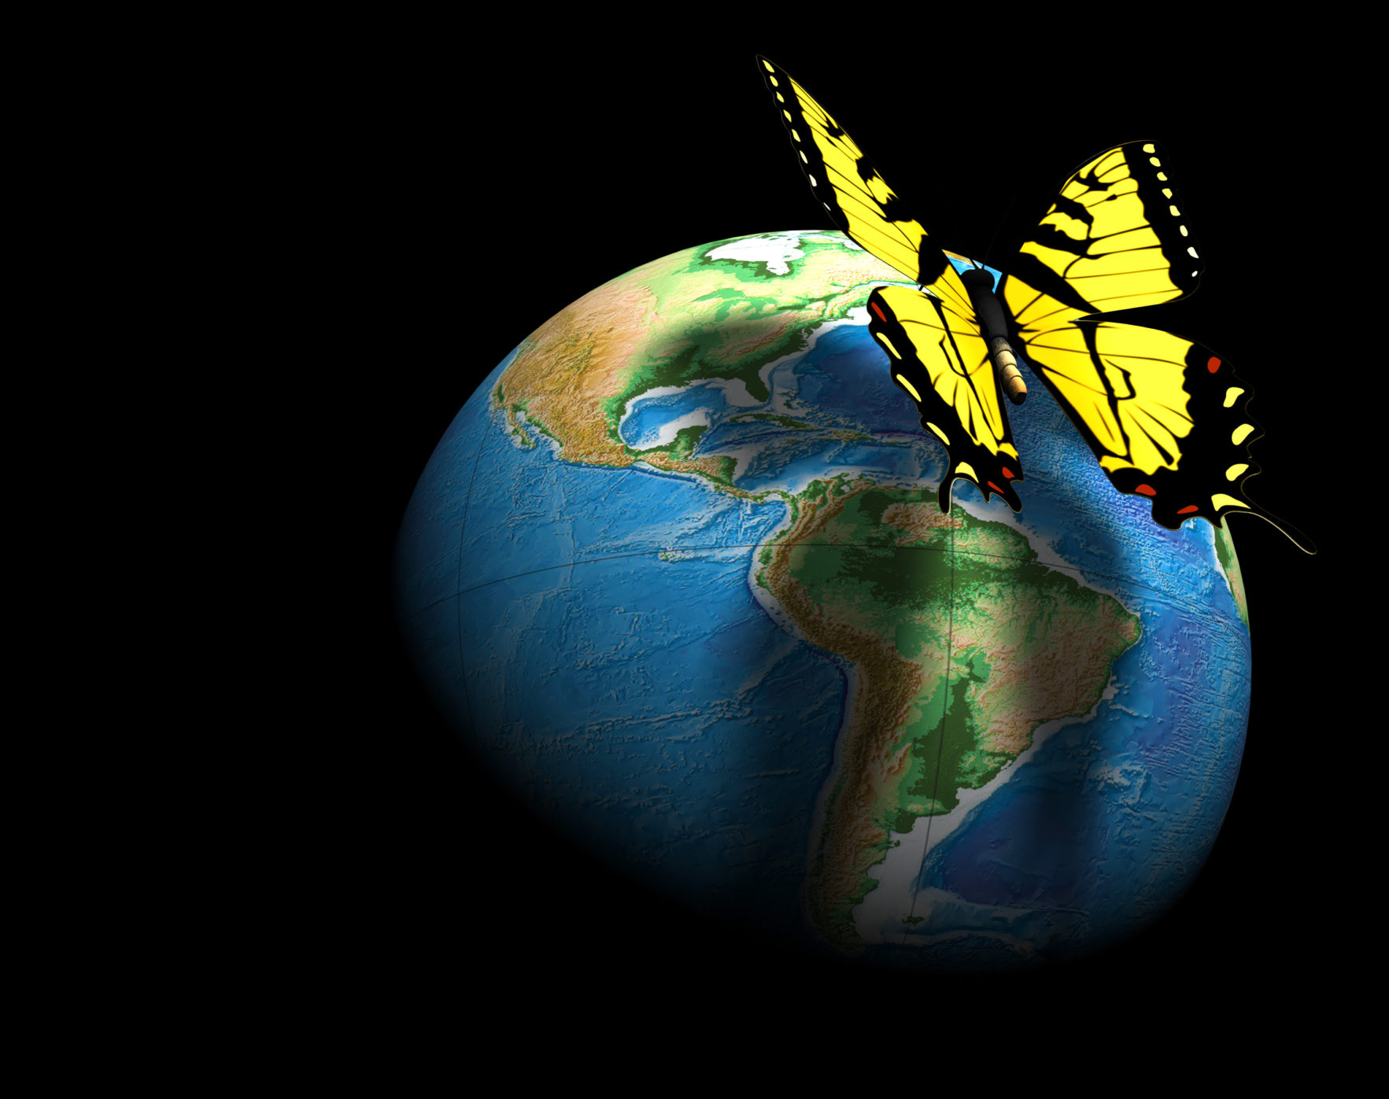
THE BUTTERFLY EFFECT
DHARNIHA V
2320429

Slide 2
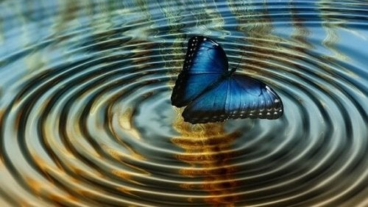
BUTTERFLY EFFECT?
The butterfly effect refers to the sensitive dependency on initial conditions in a system.
It suggests that a small change at one point can lead to significant differences in the system’s state later.

Slide 3
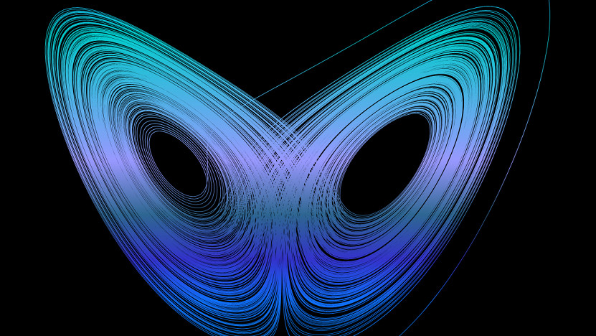
ORIGIN
The theory derives its name from an example given by Lorenz.
He proposed that the flap of a butterfly’s wings in Brazil could set off a chain of events that eventually leads to a tornado in Texas
Lorenz called this "sensitive dependence on initial conditions" when he introduced his work to the public in a 1963 paper titled, "Deterministic Nonperiodic Flow."
The term "butterfly effect" he coined in later speeches about the topic

Slide 4
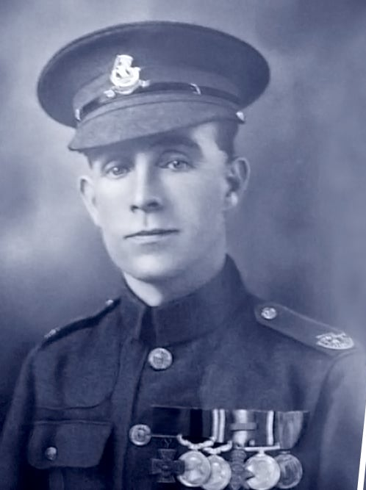
The Humane Gesture That Led To The Death Of 75 Million People!
Henry Tandey, a British soldier, was fighting in France in 1918 when he decided to spare one young German’s life who had entered his line of fire. But he didn't.
If not for Henry’s kind gesture, that young German would have undoubtedly been dead.

Slide 5
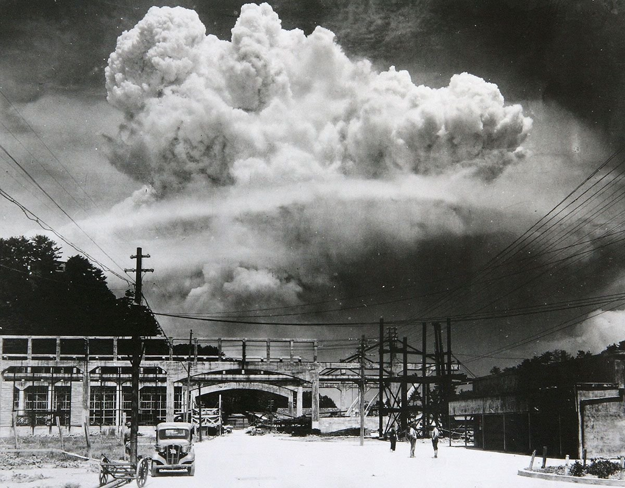
LUCKIEST CITY
The US initially intended to bomb the Japanese city of Kuroko as a target
The airplane passed over the city three times before the pilots gave up
Military personnel decided on Nagasaki as the target due to weather conditions of Kuroko

Slide 6
If Not For A Wrong Turn, The First World War Could Have Been Prevented!
On June 14th, 1914, Franz’s car was attacked by a serbia, which missed his car, instead, injuring the passengers of a car travelling behind him
Later one day , driver took a wrong turn and his car stalled in front of a shop where a member of the same terrorist group, Gavrilo Princip, a Serbian, happened to be buying a sandwich
Without missing his chance, he took the shot, murdering the France and his wife

Slide 7
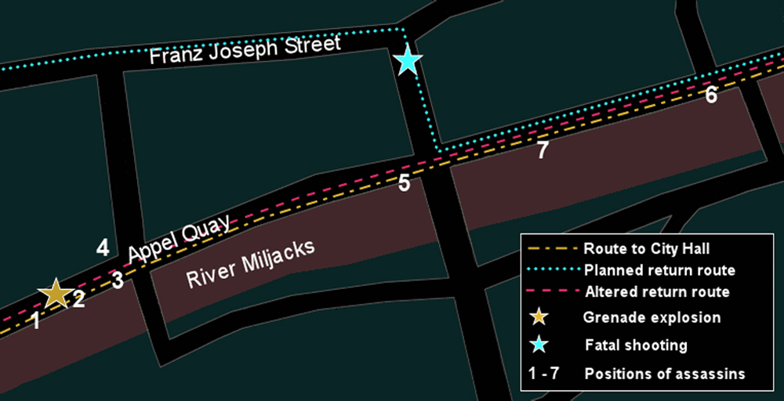
Austria and Hungary would not have declared war on the assassins’ home country of Serbia, causing Germany to declare war on Russia, followed by France and Belgium.
This caused the U.K. to declare war on Germany, thus starting World War 1.
All these events were an outcome of the chain reaction launched by a wrong turn

Slide 8
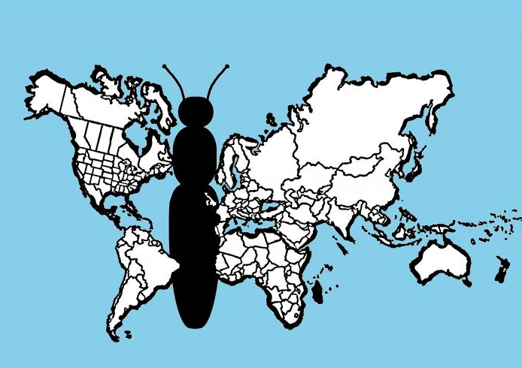
REFLECTIONS
One rupee donated from your money can change your life or somebody else’s life
when a single person buys or sells stock on Wall Street which will affect international economies for months to come
Small gestures in relationships hold immense impact

Slide 9
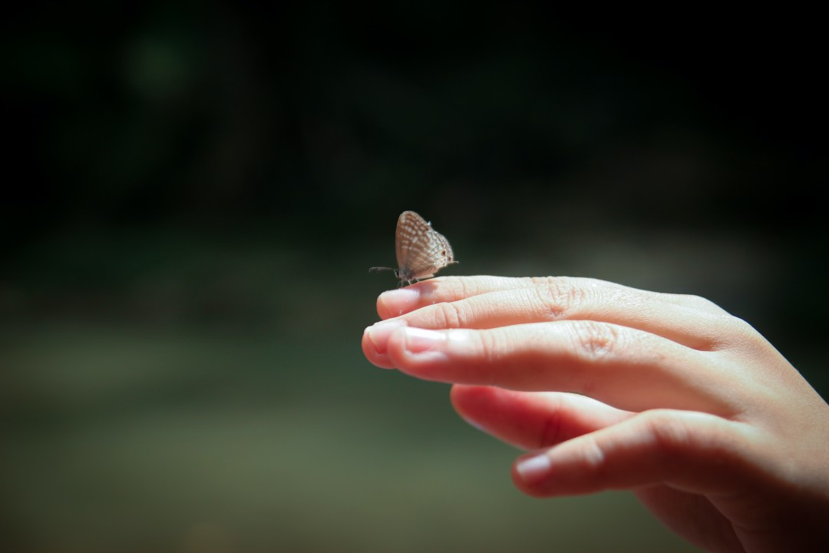
TWO TAKE AWAYS!
One is that some small events can have big consequences.
Predicting exactly what will happen as time goes on gets more difficult as time progresses, so we are bound to make mistakes no matter how much we know about something now

Slide 10
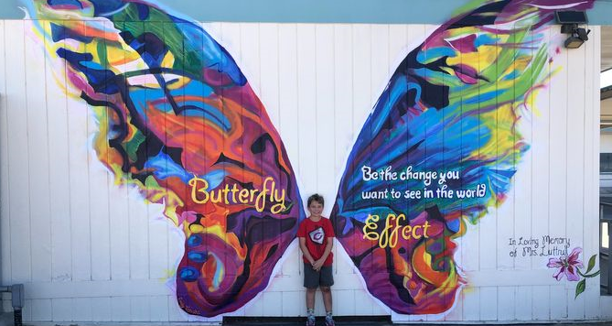
THANK YOU

